Slide 1





PROSPECTUS
March 14-17, 2027
HILTON TOKYO
Tokyo, Japan
CONGRESS LANGUAGE
English
Lourenço Falley
Industry Liaison and Sales Manager
lfalley@paragong.com

Slide 2
WELCOME ISDA 2027
Dear Distinguished Colleagues,
Welcome to the Congress of the International Sleep Disorder Academy.
On behalf of the organizing committee, it is our utmost pleasure and honor to extend a warm welcome to all esteemed doctors, researchers, and professionals in the fields of sleep medicine and sleep surgery, as we gather for the International Congress on Sleep Medicine and Surgery. This remarkable event will take place from the 14th to the 17th of March 2027 in Tokyo, Japan, offering a dynamic platform for sharing knowledge, fostering collaboration, and advancing our understanding of sleep-related health.
We are delighted to host this year’s congress in Tokyo, a global hub that seamlessly blends profound traditions with cutting-edge technological innovation. Japan’s commitment to excellence in healthcare and scientific advancement makes it the perfect backdrop for our multidisciplinary gathering. Tokyo’s unique spirit of hospitality, combined with its status as a center for world-class medical research, provides an inspiring environment that we are confident will elevate our professional discourse and strengthen our collective efforts.
We are excited to bring together leading experts from diverse specialties reflecting the multidisciplinary nature of sleep health. The congress will feature the latest in research, innovative techniques, and evidence-based therapies across various aspects of sleep medicine, from diagnosis to treatment. Our goal is to advance the field through engaging lectures and thought-provoking discussions.
This year’s lineup of distinguished speakers will share their expertise and insights, ensuring a rich exchange of ideas and best practices. We encourage all attendees to actively participate in discussions, exchange ideas, and make the most of this opportunity to build lasting professional connections.
Sincerely,
Dr. Uri Alkan Chairperson, ISDA
Prof. Shintaro Chiba Local Organizing Committee Chairperson, ISDA Congress Tokyo
ISDA 2027
10th International Sleep Disorder Congress
We look forward to seeing you in Tokyo, March 14-17, 2027!

Slide 3

CONGRESS TOPICS
Insomnia: Diagnosis and Treatment Strategies
Narcolepsy and Excessive Daytime Sleepiness
Management of Refractory RLS
Sleep in the Military
Parasomnias: From Night Terrors to Sleepwalking
Circadian Rhythm Sleep Disorders: Shift Work Disorder and Delayed Sleep Phase Syndrome
Pediatric Sleep Disorders: Focus on Sleep Disorders Specific to Children
Sleep-related Breathing Disorders
Sleep in the Intensive Care Unit (ICU)
Sleep and Mental Health: The Bidirectional Relationship between Sleep and Mental Health
Aging and Sleep: Challenges and Solutions
Sleep and Women’s Health: Sleep Disorders Unique to Women, including Pregnancy-related Sleep Disturbances and Menopause-related sleep Changes
Artificial Intelligence in Sleep Medicine
Technology and Sleep: Friend or Foe?
Sleep and Neurological Disorders: Such as Parkinson’s Disease, Alzheimer’s Disease, and Epilepsy
Sleep and Cardiovascular Health
Sleep in Athletes
Sleep and Malignancy
TARGETED REGIONS
North America
South America
Europe
Asia & Pacific
Middle East
Africa
350+ Participants

Slide 4
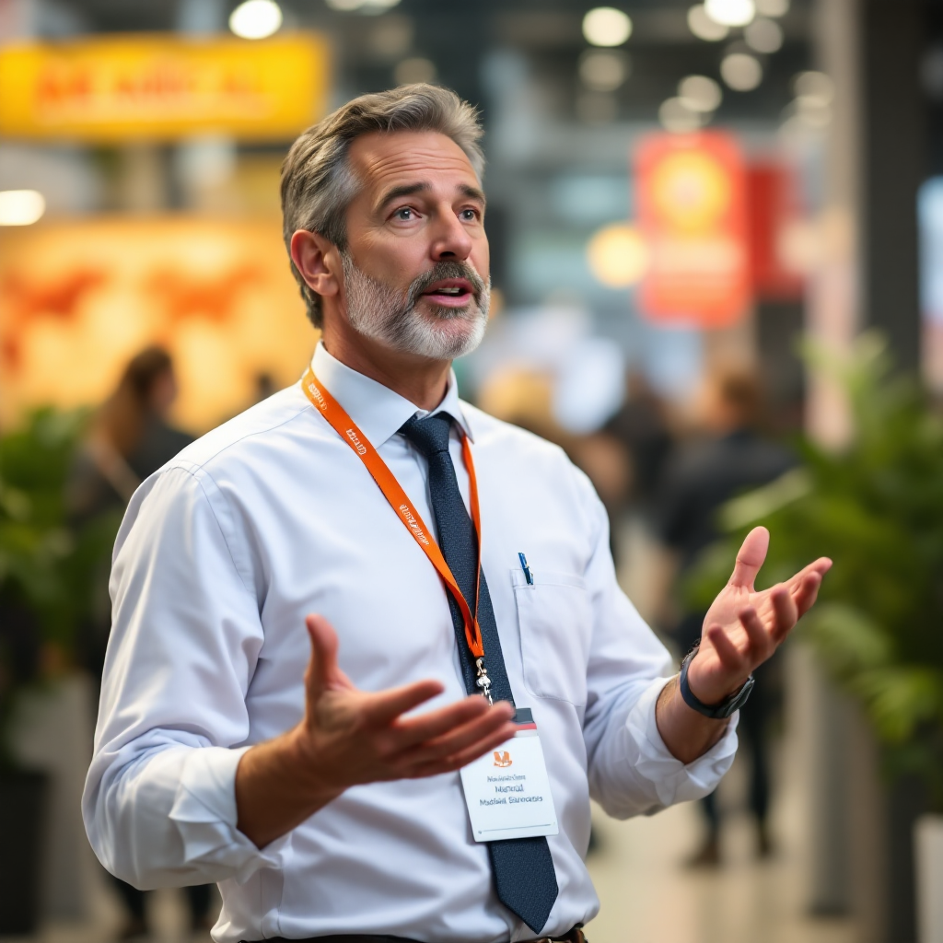
PREMIUM SPONSORSHIP
ANCHOR | Euro 15,000
SPONSOR FEATURES
5 Email - blasts to the Participants (Content will be provided by the sponsor)
5 Social Media posts
PRE-CONGRESS
Clickable logo placement:
On the Congress website
On signages on site
On the Congress app
DURING CONGRESS
45 Minute Symposium as part of the Scientific Program (subject to scientific committee approval)
6sqm Exhibition Open Space - 4x Exhibitors / Congress Badges
4x Social Congress Passes
Recognition during the Opening and Closing Ceremony & Program
Available X1

Slide 5

PREMIUM SPONSORSHIP
x1
x2
x3
PLATINUM | Euro 10,000
GOLD | Euro 8,000
SILVER | Euro 6,000
SPONSOR FEATURES
SPONSOR FEATURES
Available
SPONSOR FEATURES
Available
Available
3 Email - blasts to the Participants (Content will be provided by the sponsor)
3 Social Media posts
2 Email - blasts to the Participants (Content will be provided by the sponsor)
2 Social Media posts
1 Email - blasts to the Participants (Content will be provided by the sponsor)
1 Social Media posts
PRE-CONGRESS
PRE-CONGRESS
PRE-CONGRESS
Clickable logo placement:
On the Congress website
On signages on site
Clickable logo placement:
On the Congress website
On signages on site
Clickable logo placement:
On the Congress website
On signages on site
DURING CONGRESS
DURING CONGRESS
DURING CONGRESS
30 Minute Symposium as part of the Scientific Program (subject to scientific committee approval)
6sqm Exhibition Open Space - 3x Exhibitors / Congress Badges
3x Social Congress Passes
Recognition during the Opening and Closing Ceremony & Program
15 Minute Symposium as part of the Scientific Program (subject to scientific committee approval)
6sqm Exhibition Open Space - 2x Exhibitors / Congress Badges
2x Social Congress Passes
Recognition during the Opening and Closing Ceremony & Program
6sqm Exhibition Open Space - 1x Exhibitor / Congress Badges
1x Social Congress Pass
Recognition during the Opening Ceremony & Program

Slide 6
SPONSORSHIP OPPORTUNITIES
EXHIBITION RAW SPACE (6sqm – 3x2)
SPONSORED WORKSHOP
CONGRESS LANYARDS
A sponsored workshop provides a prime opportunity to share expert-led content on clinical innovations, emerging research or advanced treatments, while connecting them with key industry and academic stakeholders.
Branding on lanyards:
Logo will be prominently displayed on the official Congress Lanyards (sponsor will be responsible to produce and to provide the Lanyards)
2 Exhibitor badges
1 Standard electric socket
1 Table + 2 Chairs
Euro 5,000
CONGRESS BADGES
Branding on Participants' Badges:
Logo will be prominently displayed on the official Congress Badges (sponsor will be responsible to produce and to provide the Badges)
BRANDING ON COFFEE AREA
Your brand will be prominently displayed on the Coffee Stands at the Exhibition Area
Euro 3,500
Euro 1,200
Euro 2,500 / Euro 3,000

Slide 7
SPONSORSHIP OPPORTUNITIES
WELCOME RECEPTION | Euro 7,200
An exclusive opportunity for branding rights at the Network Cocktail Function. The sponsor will have the opportunity to place branding at the event on the evening, in accordance with guidelines stipulated by committee and the venue.
SPONSORED LUNCH BREAK | Euro 3,500 / day
Opportunity to sponsor the daily lunch breaks at the conference. Option to display your company logo/add banners and offer promotional items to attendees during lunch.
NEWSLETTER | Euro 1,500
The Sponsoring Company will have the opportunity to have full recognition on the Congress app, including a splash image on landing page, company profile, logo, contact details on the home page and 1x push notification per day during the Congress.
ADVERTISING | Euro 2,000 per ad
Full-page colour advertisement(s) are available in the Congress app Format: PDF (single or multiple pages) or printed on page A5

Slide 8


PROSPECTUS
March 14-17, 2027
Paragon World Medical Event
Mr. Lourenço Falley
Industry Liaison and Sales Manager
E-mail: lfalley@paragong.com
Phone Number:+351 919 708 262
pwme.audrey@gmail.com
WEBSITE
www.isda-congress.com
Nathalie
Mobile Contact: +33 6 60 97 15 32
We look forward to seeing you in Tokyo, March 14-17, 2027!

